Slide 1
Sale of Parsonages
Requirements & Considerations

Slide 2
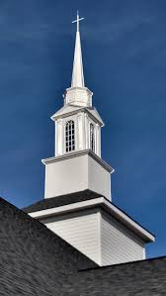
Book of Discipline Requirements – Prior to Sale
The sale of a parsonage, like the sale of any church real estate, is subject to the requirements of The Book of Discipline of The United Methodist Church.
Per BoD P 2540 & 2541:
Full investigation by the Pastor, District Superintendent and District Board of Church Location and Building that results in a plan of action for the future missional needs of the community.
Approval of Pastor, District Superintendent and District Board of Church Location and Building.
Certification by the District Superintendent that the transfer conforms to the BoD.
Approval by a majority vote of those present at a duly called Charge Conference.
Written consent of the Pastor and District Superintendent.
Signature of two officers of the Board of Trustees on sale-related instruments.

Slide 3
Book of Discipline Requirements – Use of Proceeds
The use of parsonage proceeds is subject to certain restrictions outlined in The Book of Discipline of The United Methodist Church.
Per BoD P 2543:
Principal proceeds of a sale of church property may not be used for the current budget or operational expense of the church.
Principal proceeds may be used for capital improvements beyond the regular operating budget upon written approval by the Pastor and District Superintendent if adequate provisions have been made to meet the housing needs of the Pastor. Examples include: additions, renovations, new roof or HVAC updates.
Can be used for the purchase or construction of a new parsonage.

Slide 4
Book of Discipline Requirements – Use of Proceeds
Investment income generated from proceeds of a sale of church property may used for:
A Housing Allowance paid to the pastor, which is considered to be an operating expense of the church
Other operational expenses of the church
Exceptions may be granted to allow principal proceeds to fund congregational redevelopment efforts including program and staff.
Requires approval of Annual Conference, the Bishop and the Cabinet upon request from church in consultation with Congregational Developer.
A clear and detailed three-to-five-year redevelopment plan that projects a self-supporting ministry must accompany the request.

Slide 5
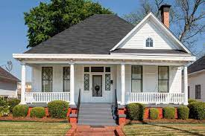
Investment Management
The Frontier Foundation can assist churches with investing proceeds by:
Understanding investment objectives
Understanding risk tolerance
Designing an Investment Policy
Suggesting appropriate investments, developing an investment plan and managing funds to meet objectives
Distributing income as needed
Ellen Knudsen
Executive Director
eknudsen@umff.org
20 Soundview Ave
White Plains NY 10606
914-615-2238

